Slide 1
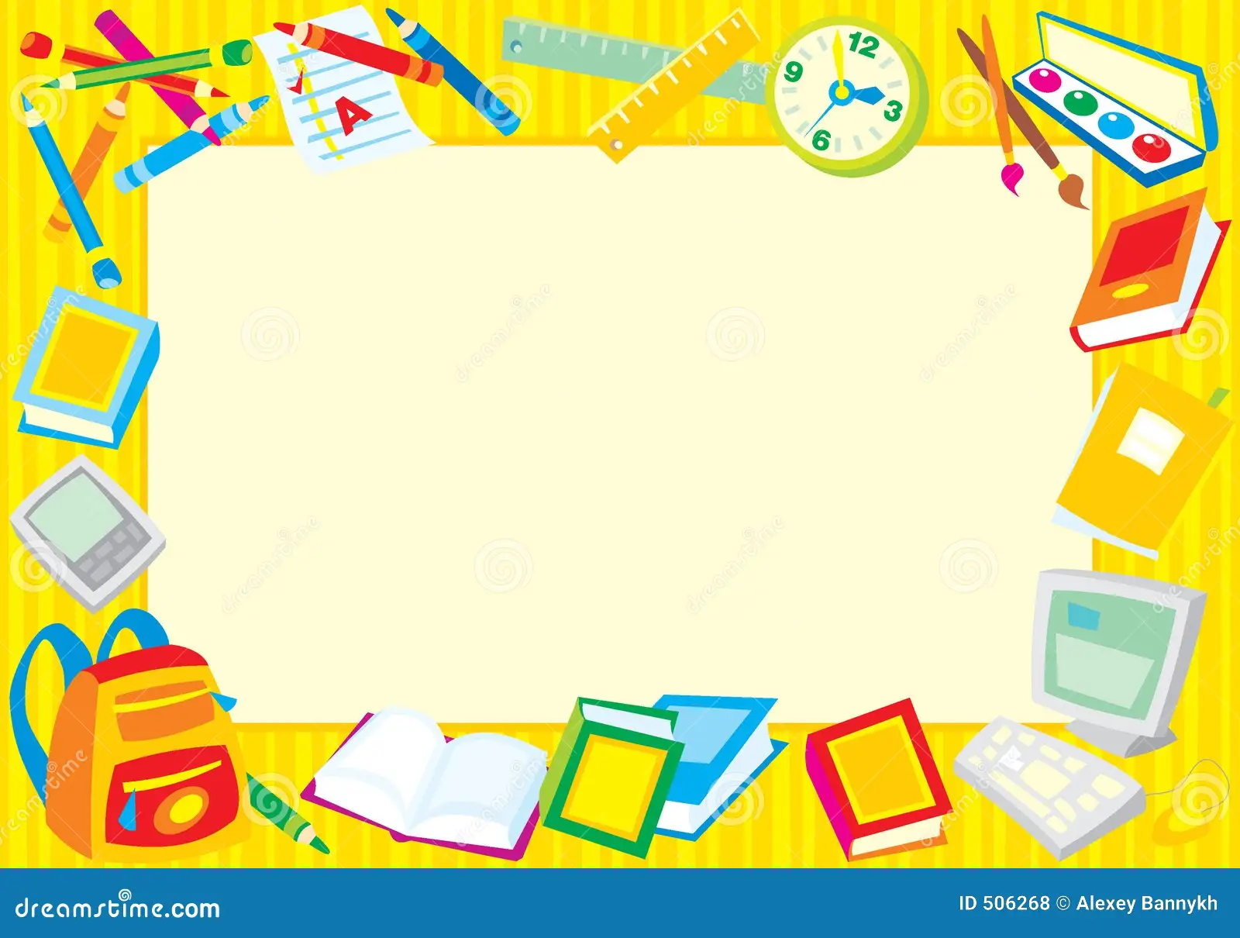
Fun-n-Games Store:
A Store for Teachers
The Fun-n-Games store is a store online for teachers and other educators to purchase games and activities on a wide variety of skills including math, phonics, reading, and many more. The games are easy to download and prepare and require a minimal amount of preparation. They are aligned to the Common Core Standards and work with students on a wide range of skill levels.

